Slide 1

VIRTUAL ASSISTANT
Based On AI
A project by :
Ashwani Kumar(20111011)
Ayushman Singh Rathore(20111014)
Dev Srivastava(20111017)

Slide 2

PYTHON
Python is an interpreted, object-oriented, high-level programming language with dynamic semantics.
The Python interpreter and the extensive standard library are available in source or binary form without charge for all major platforms, and can be freely distributed.
Its edit-test-debug cycle is incredibly fast.
Friendly & Easy to Learn

Slide 3


FEATURES of GENIUS
Virtual assistant : Genius
A virtual assistant, is an application program that understands natural language voice commands and completes tasks for the user.
Wish according to time
Send E-Mail
Set Timer
Summary From Wikipedia
Open Websites & Applications
Play Online & Offline music
Tell Jokes
Convert Codon to Protein
Make Notes
Current Date and Time
Lock Window
Restart
Shut down

Slide 4
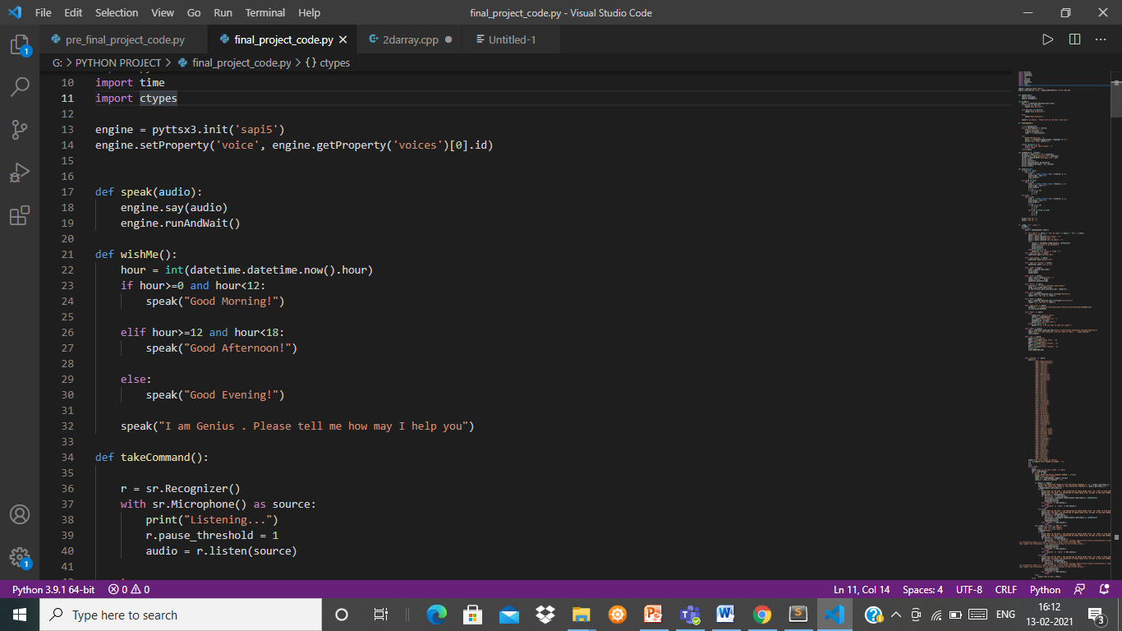
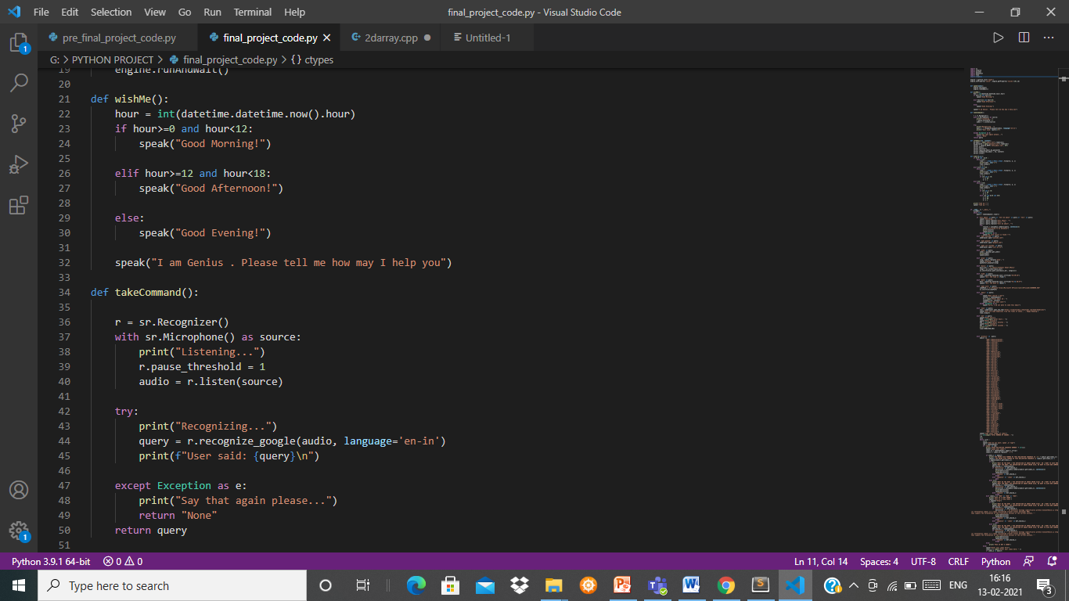
Defining function for Text to Speech
Defining function for Speech to Text

Slide 5
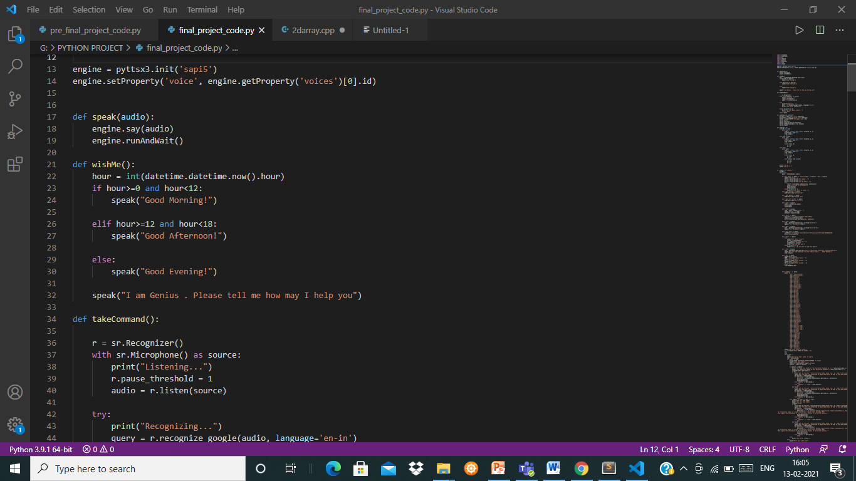
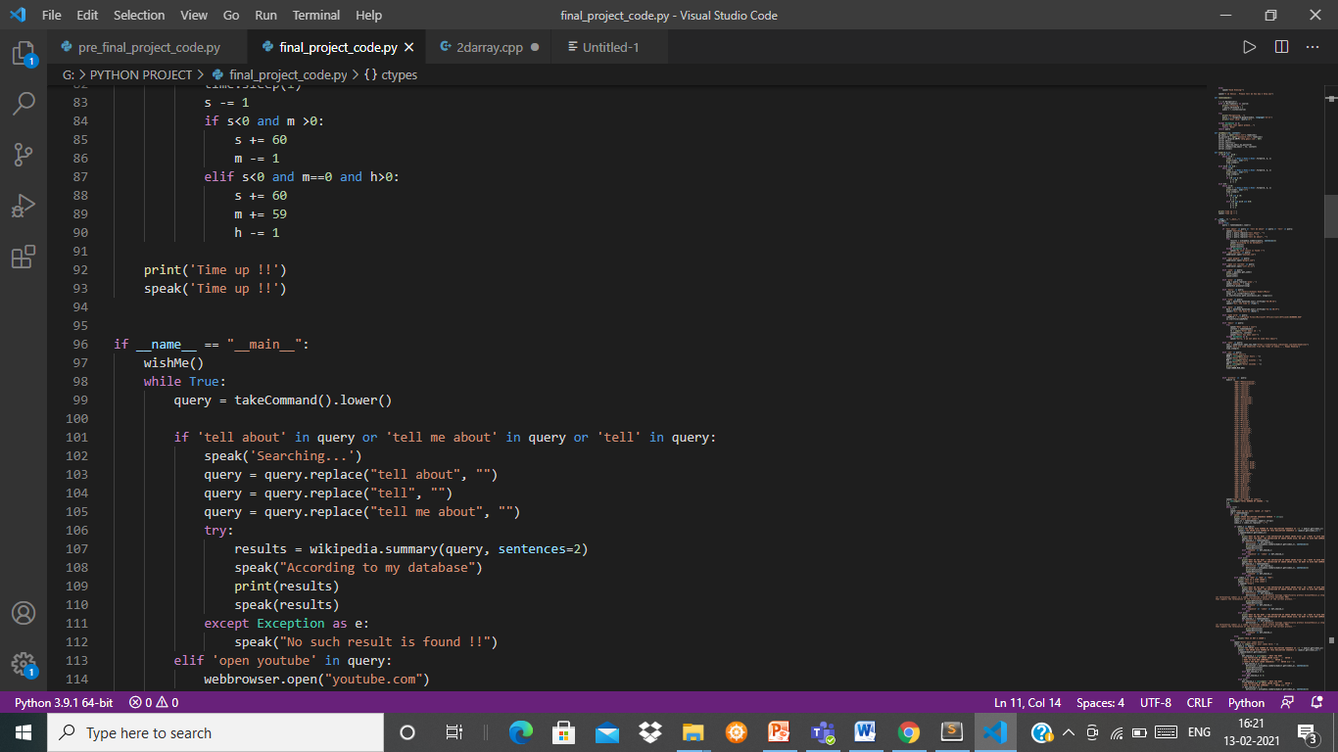
Defining function for wishing me according to time
Executing wishMe function

Slide 6
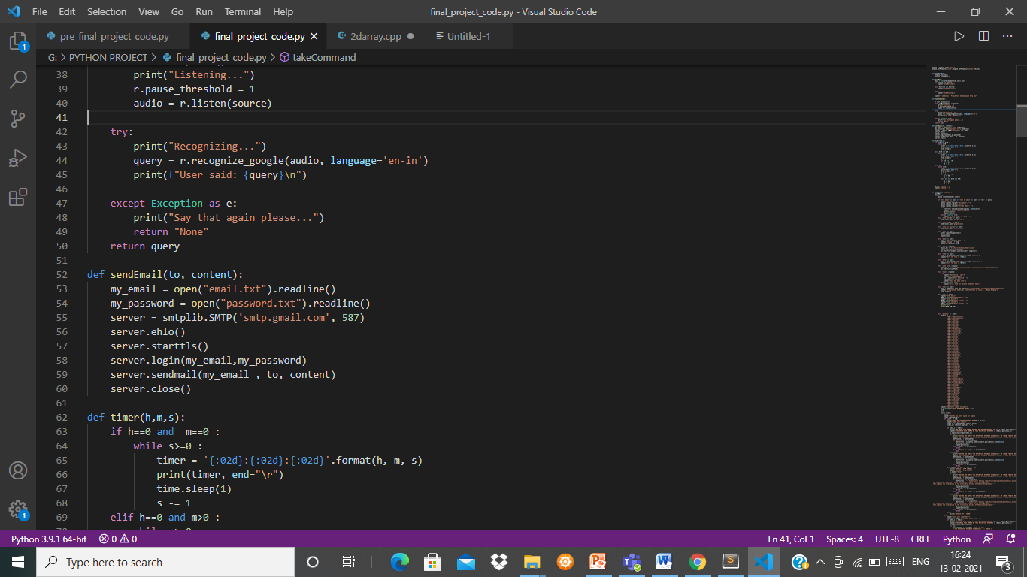
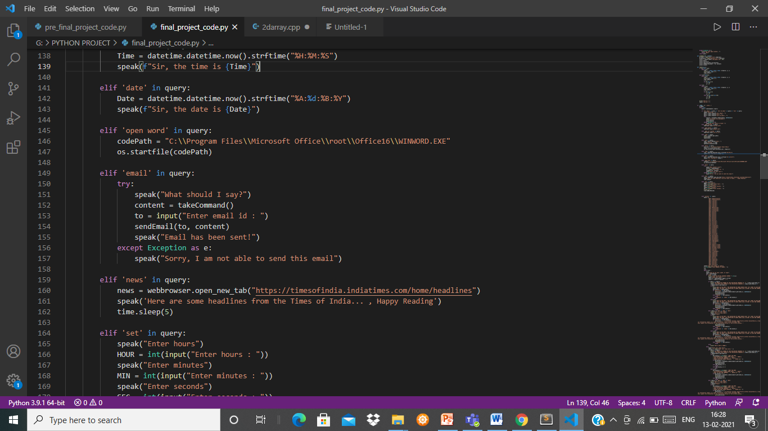
Email
Defining function for Sending Email
Executing sendEmail function

Slide 7
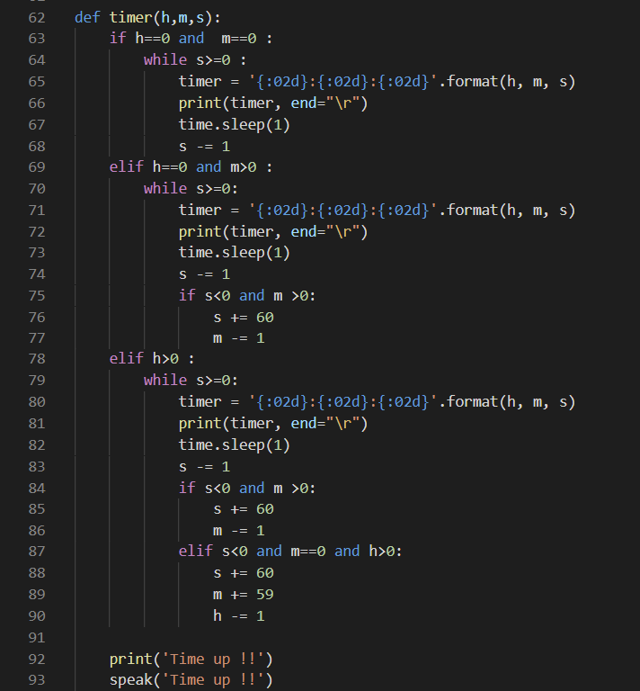
Timer
Defining function for Setting Timer

Slide 8
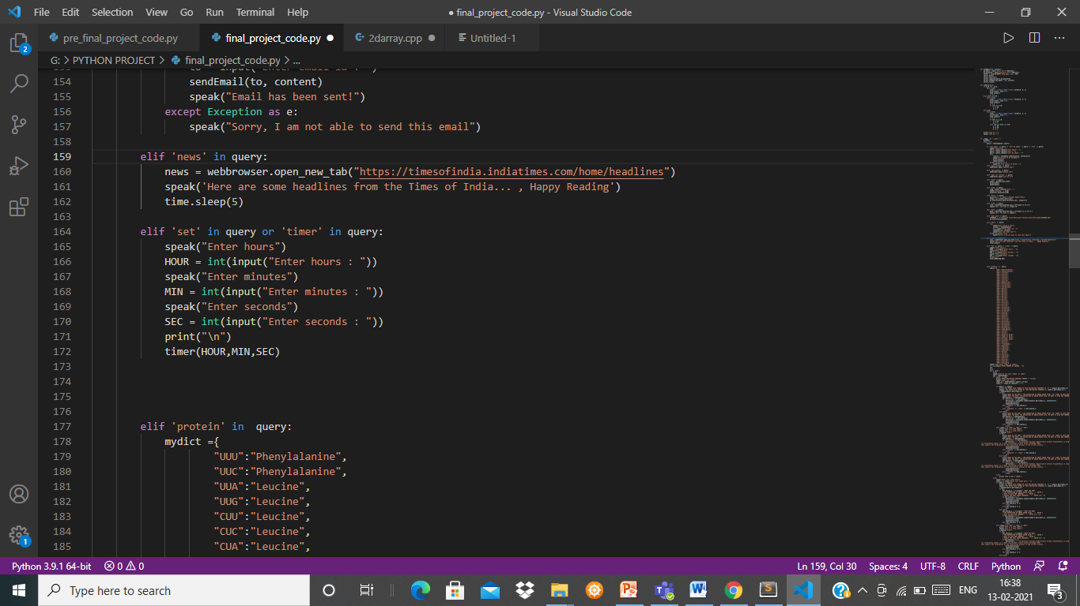
Executing timer function

Slide 9
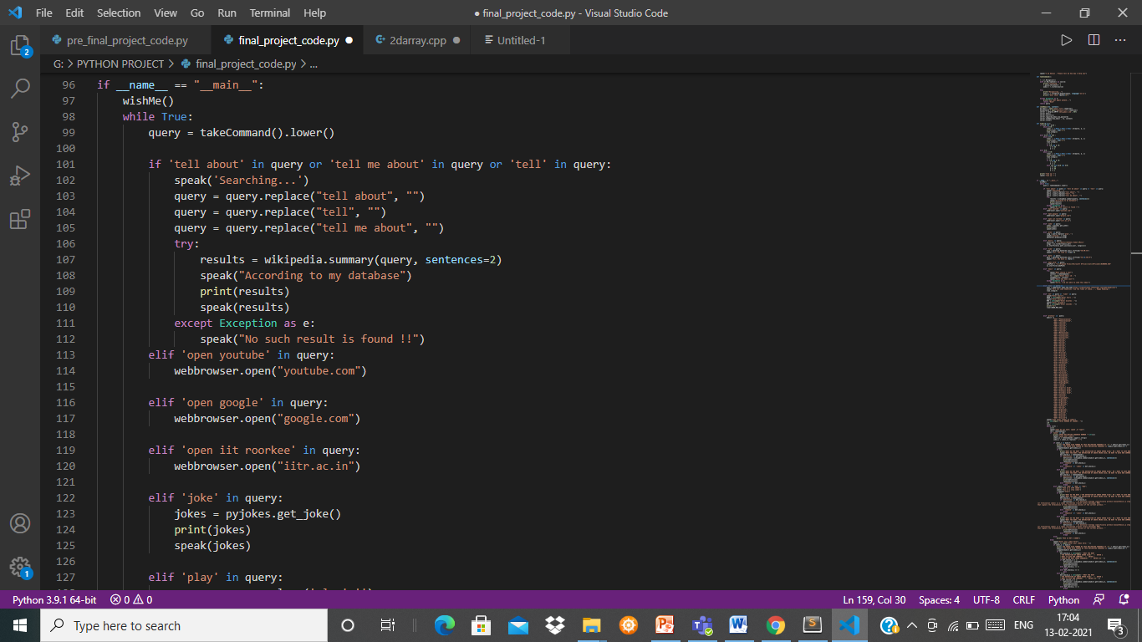
Wikipedia
Summary from Wikipedia

Slide 10
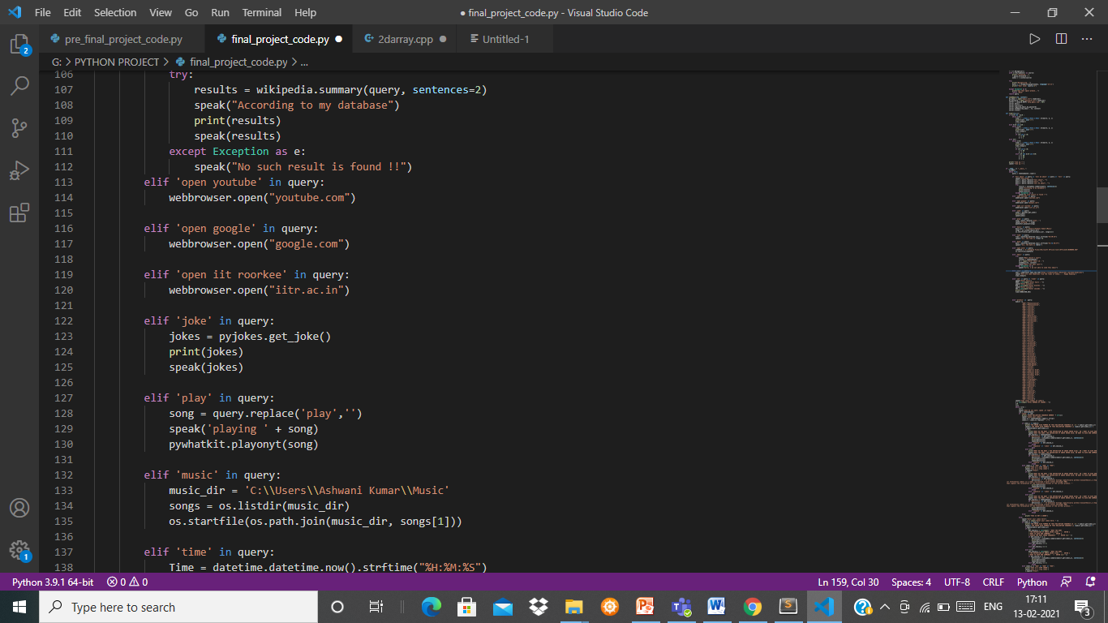
Open Websites
Jokes
Online Music
Offline Music

Slide 11
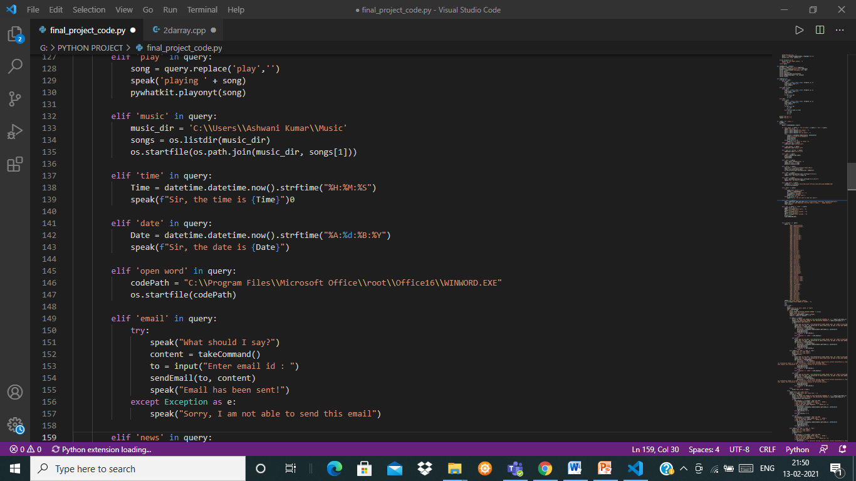
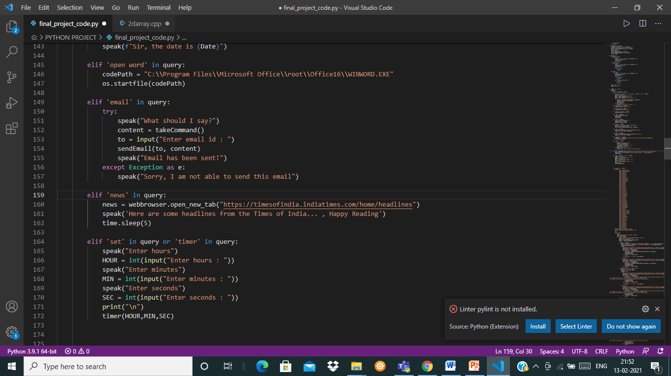
Date & Time
Open Application
News

Slide 12
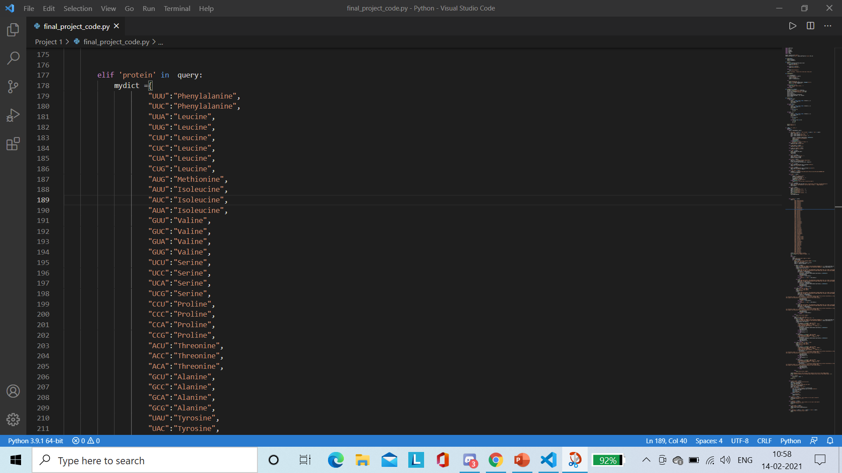
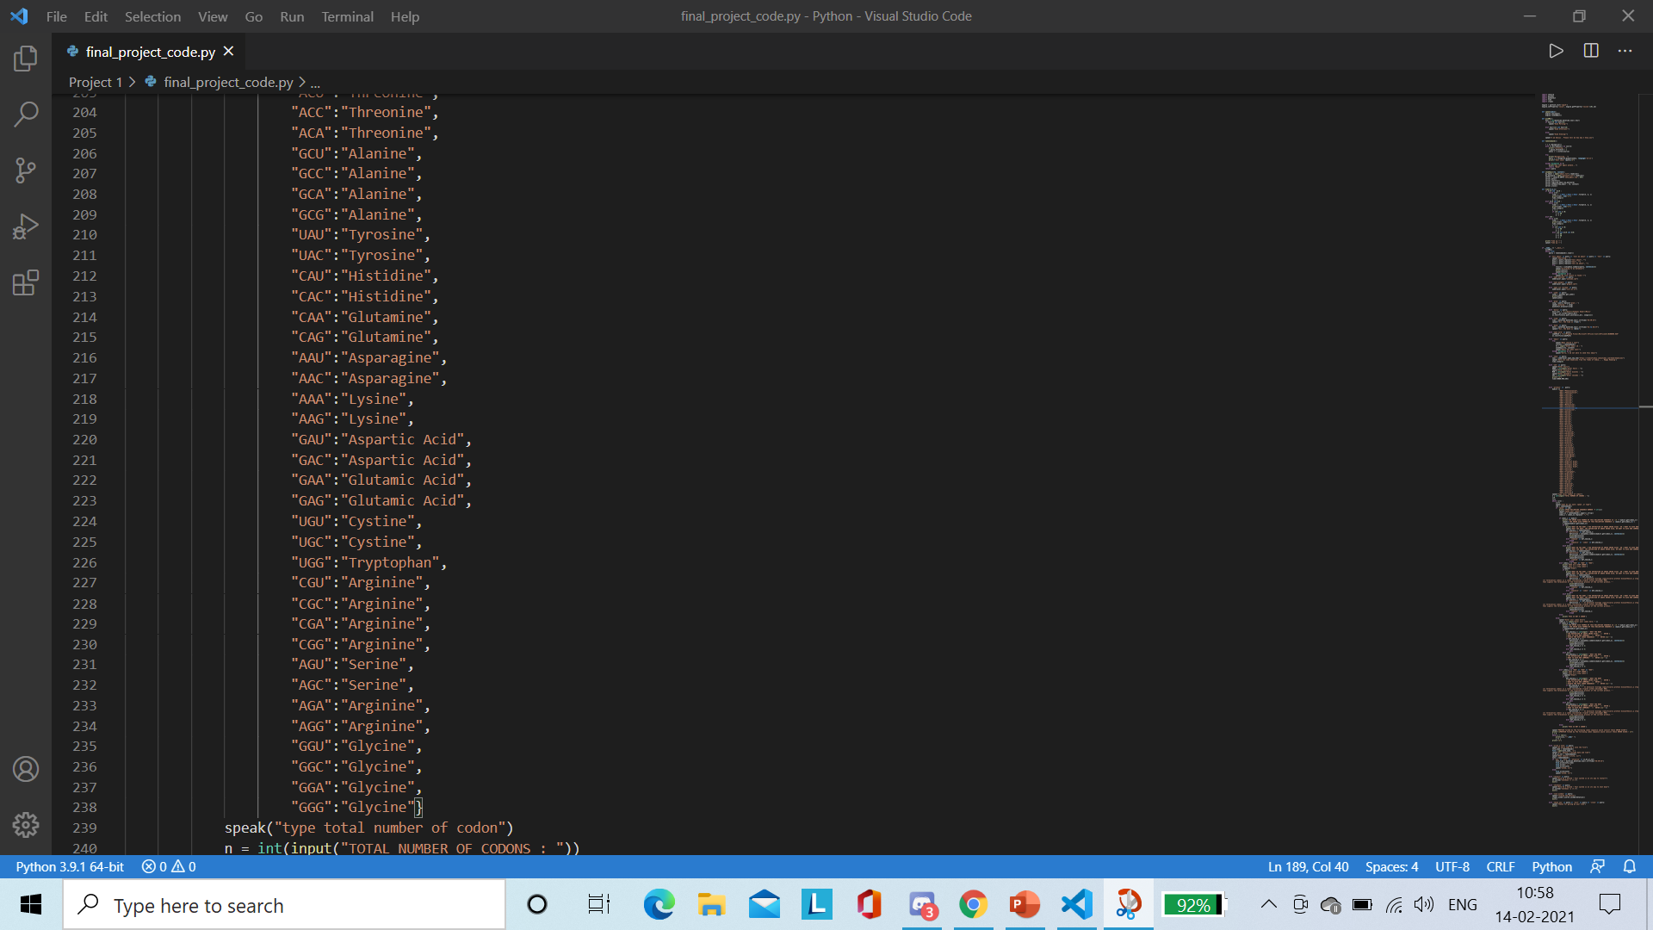
Codon to Protein
Defining Dictionary

Slide 13
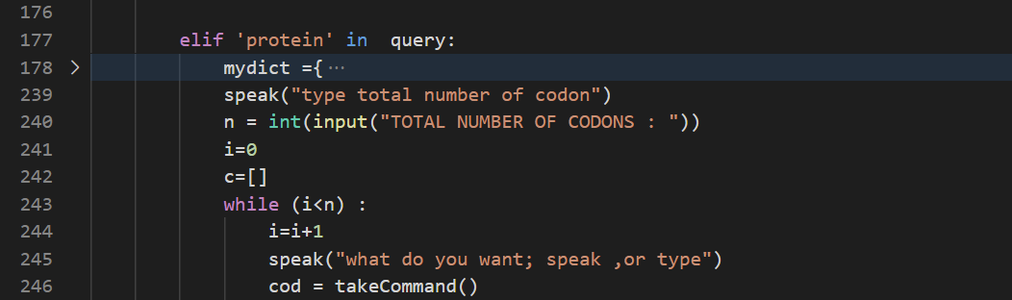
Asking for no. of codon
Asking for speak or type

Slide 14
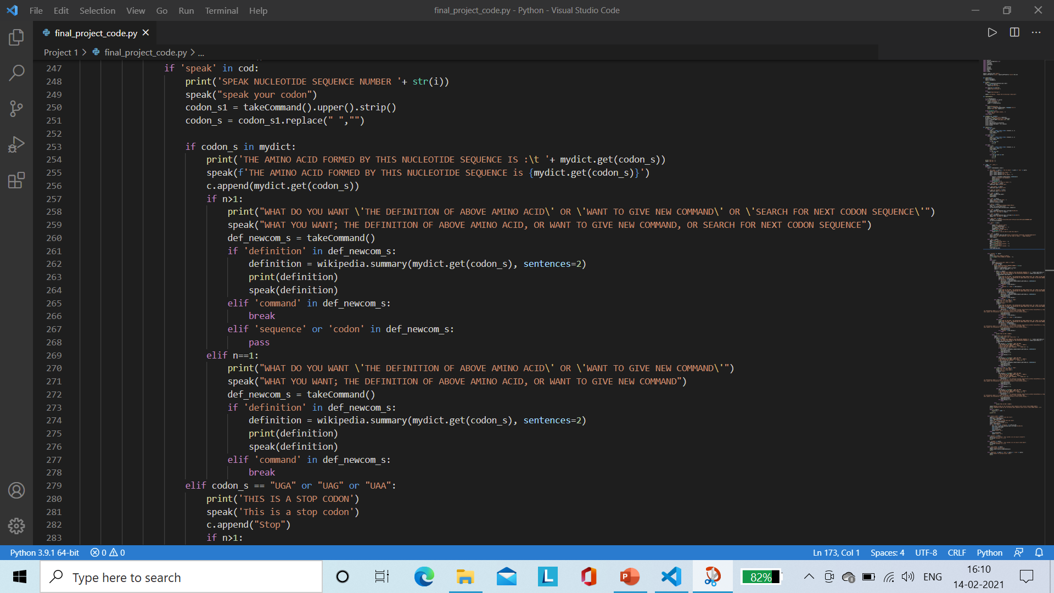

Slide 15
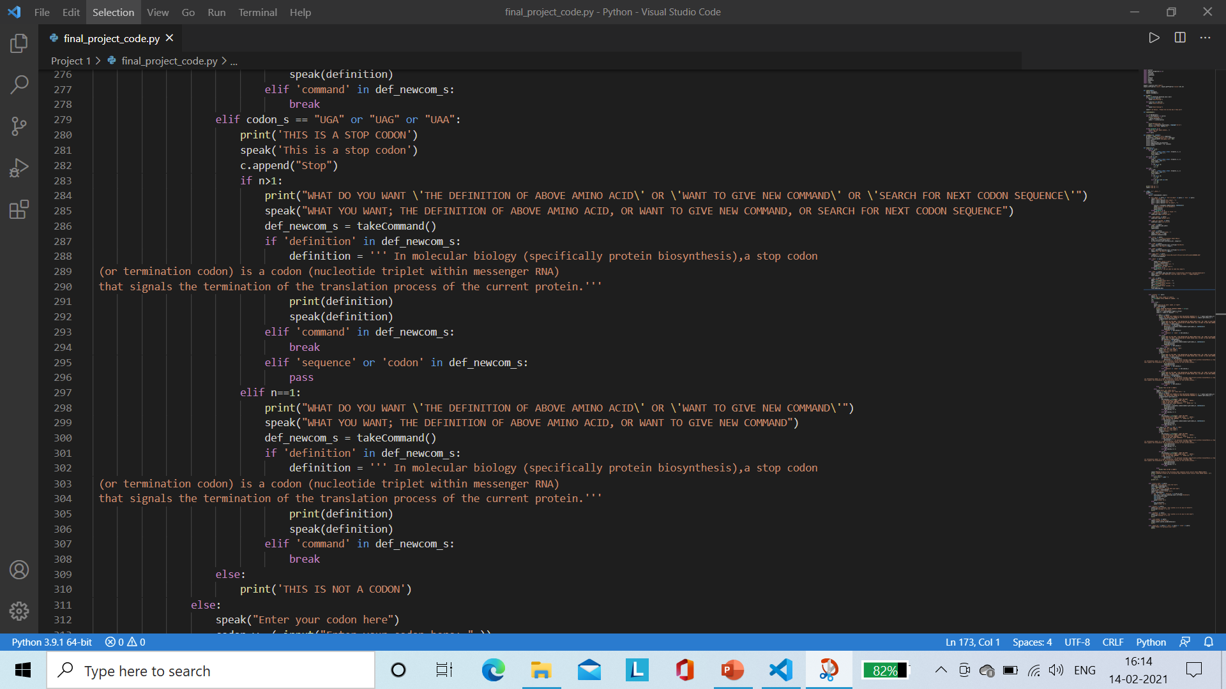

Slide 16
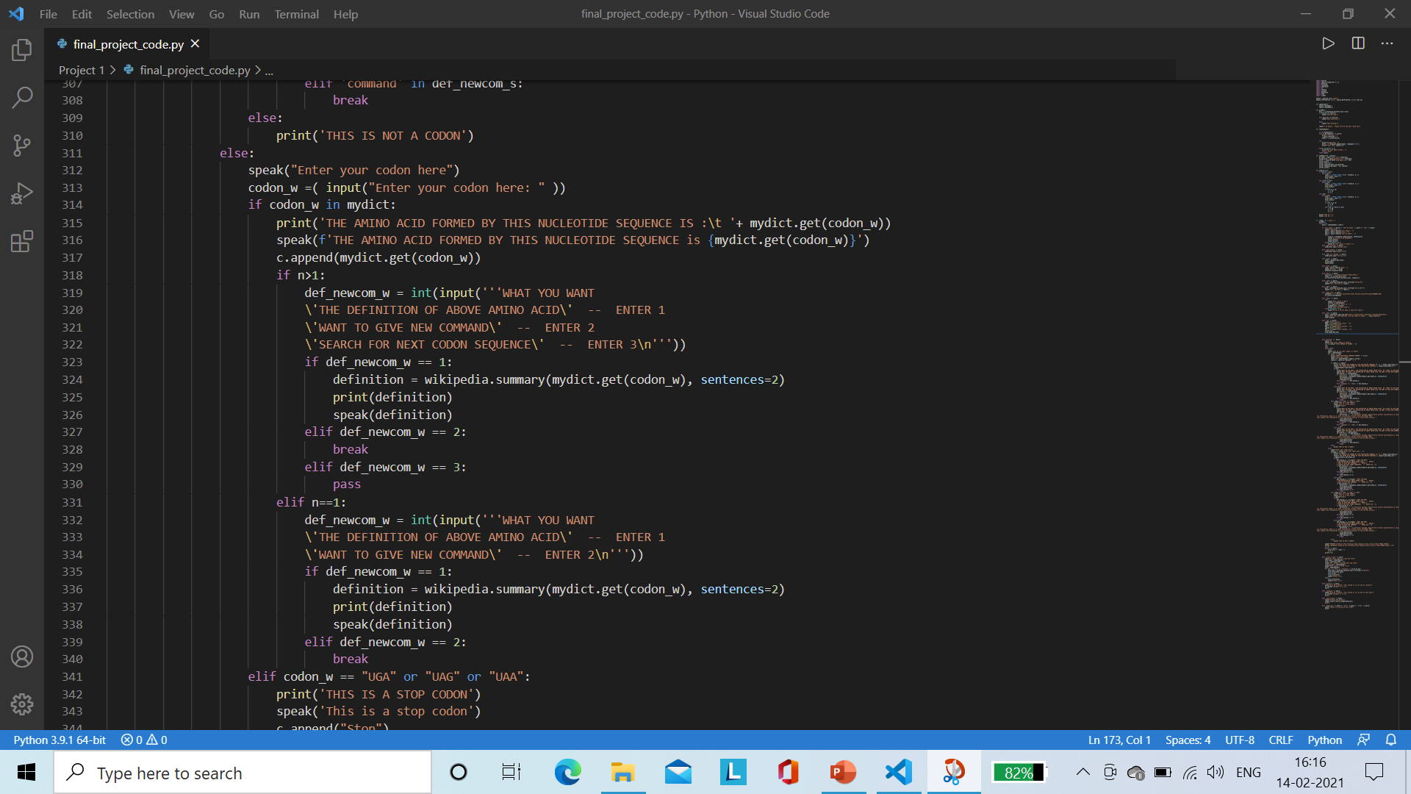

Slide 17
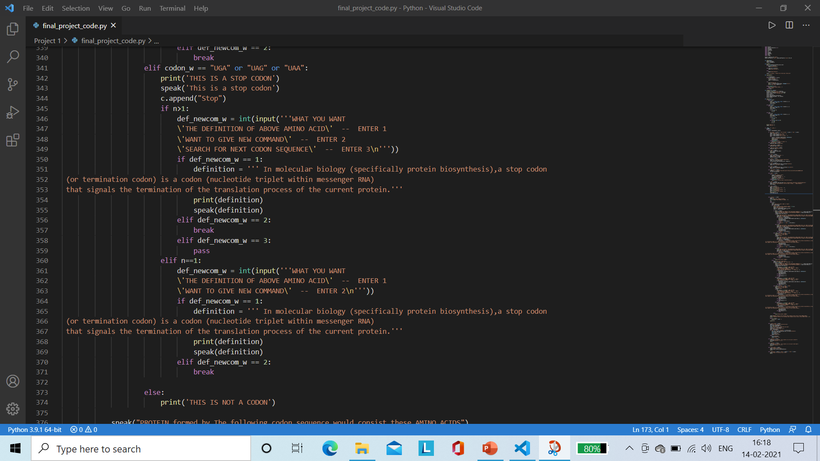

Slide 18
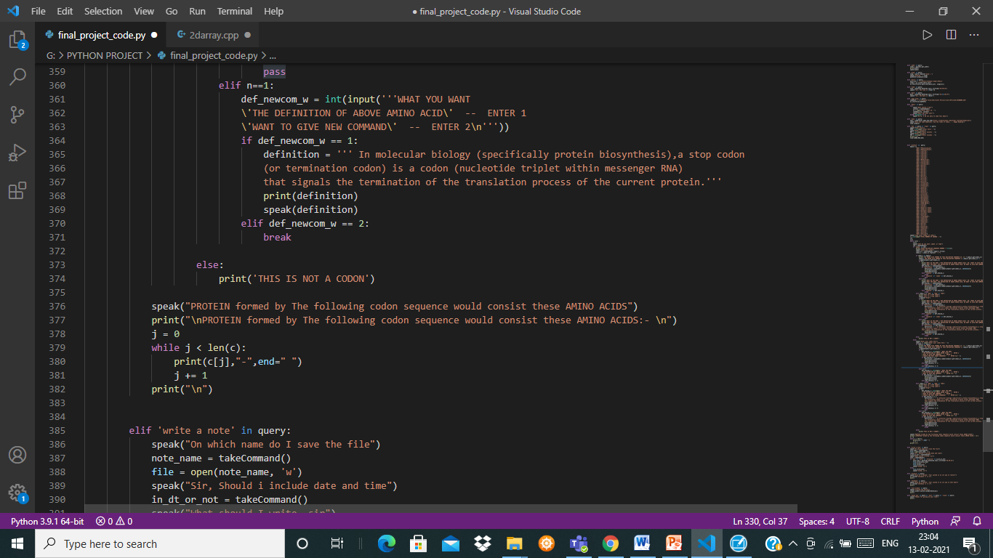

Slide 19
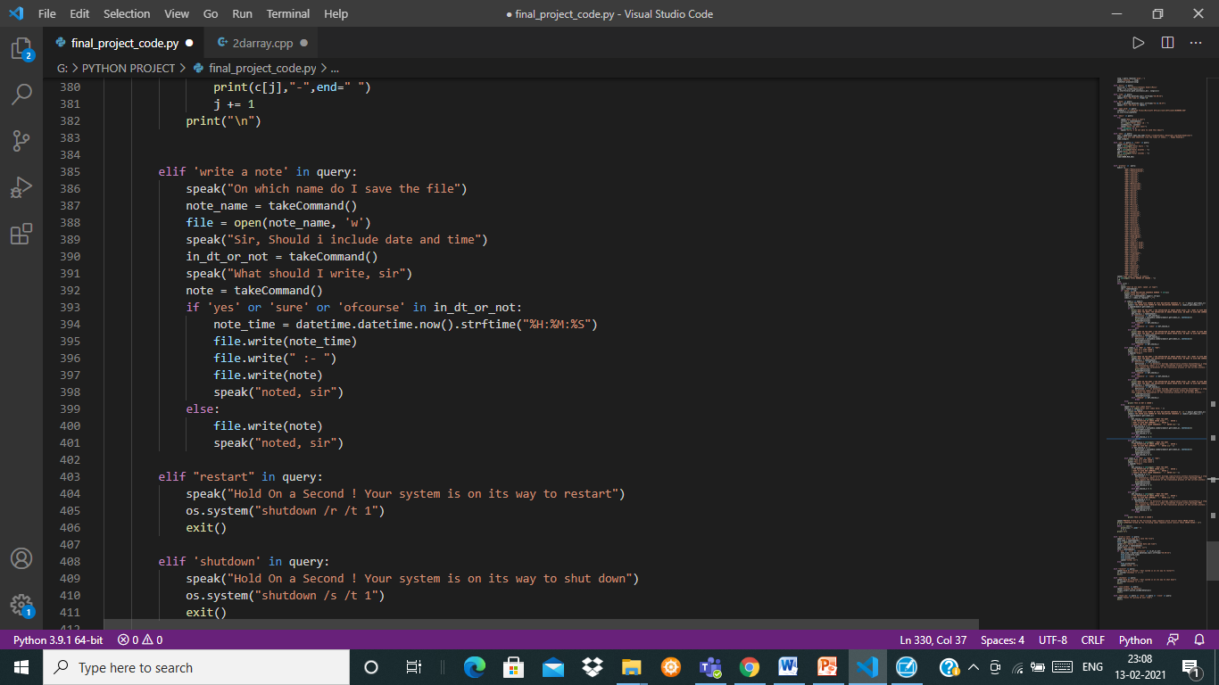
Writing a Note

Slide 20
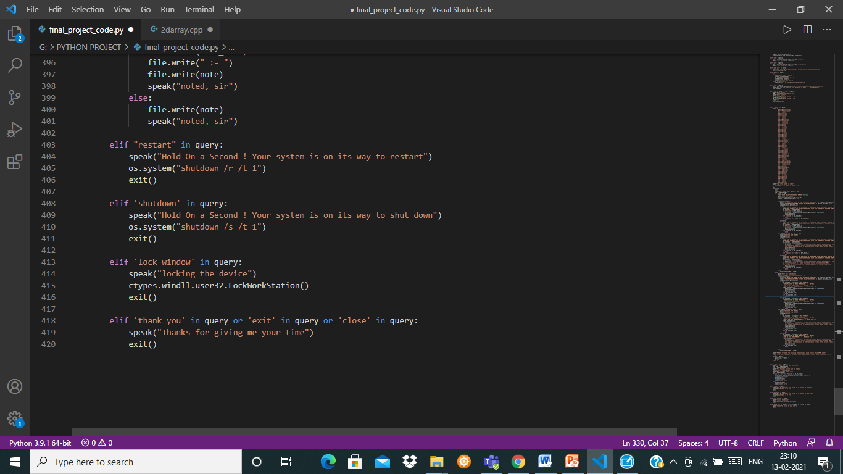

Slide 21
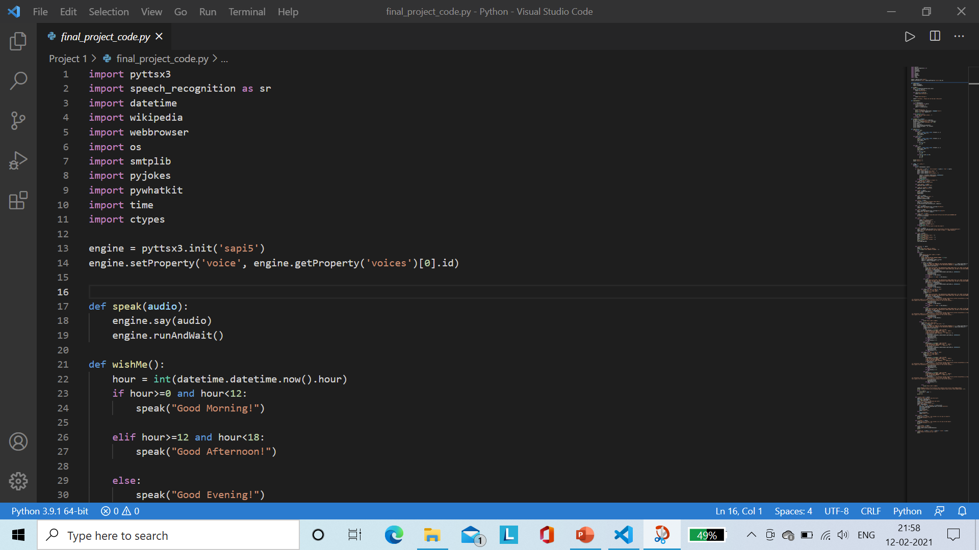
Library used
PYTTSX3 : It is a text-to-speech conversion library in Python. Unlike alternative libraries, it also works offline.
SPEECH RECOGINITION : It is a library for performing speech recognition, with support for several engines and APIs, online and offline.
DATETIME : This module supplies classes to work with date and time. These classes provide a number of functions to deal with dates, times and time intervals.
WIKIPEDIA : It makes easy to access and parse data from Wikipedia.
WEBBROWSER : It provides a high-level interface to allow displaying Web-based documents to users.
OS : The OS module in python provides functions for interacting with the operating system.

Slide 22
SMTPLIB : It defines an SMTP client session object that can be used to send mail.
PYJOKES : It is used to create one-line jokes for programmers.
PYWHATKIT : It is a Python library for sending Playing a YouTube video, Performing a Google Search, Getting information on particular topic.
TIME : The Python time module provides many ways of representing time in code and also provides functionality like waiting during code execution and measuring the efficiency of your code.
CTYPES : It provides C compatible data types, and allows calling functions in DLLs or shared libraries. It can be used to wrap these libraries in pure Python.

Slide 23
THANK YOU

